Slide 1
SQL FUNCTIONS and GROUP BY

Slide 2
Outline
SQL Functions
COUNT
MAX
MIN
AVG
SUM
SQL GROUP BY

Slide 3
SQL Aggregate Functions
An aggregate function is a function that performs a calculation on a set of values, and returns a single value.

Slide 4
SQL Aggregate Functions
The most commonly used SQL aggregate functions are:
MIN() - returns the smallest value within the selected column
MAX() - returns the largest value within the selected column
COUNT() - returns the number of rows in a set
SUM() - returns the total sum of a numerical column
AVG() - returns the average value of a numerical column

Slide 5
transactions
transaction_id | amount | customer_id | order_date
1000 | 4.99 | 3 | 2025-01-01
1001 | 2.89 | 2 | 2025-01-01
1002 | 3.38 | 3 | 2025-01-02
1003 | 4.99 | 1 | 2025-01-02
1004 | 1.00 | null | 2025-01-03

Slide 6
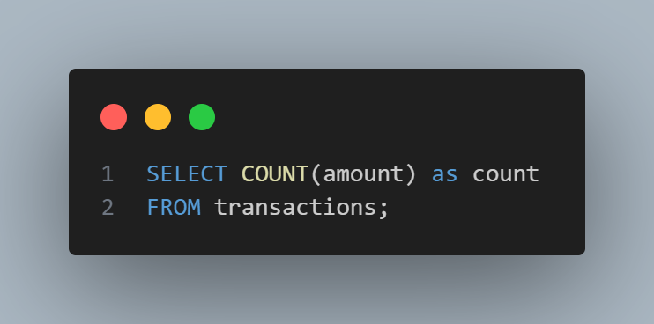
transactions
transaction_id | amount | customer_id | order_date
1000 | 4.99 | 3 | 2025-01-01
1001 | 2.89 | 2 | 2025-01-01
1002 | 3.38 | 3 | 2025-01-02
1003 | 4.99 | 1 | 2025-01-02
1004 | 1.00 | null | 2025-01-03
Result:
count
5

Slide 7
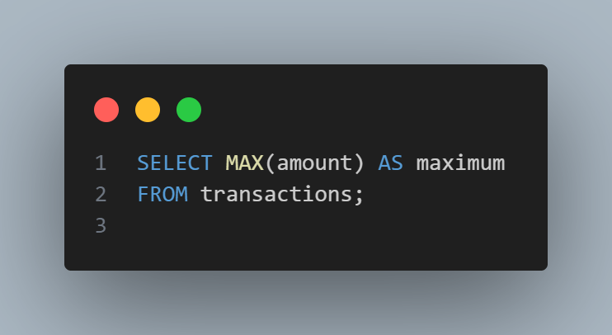
transactions
transaction_id | amount | customer_id | order_date
1000 | 4.99 | 3 | 2025-01-01
1001 | 2.89 | 2 | 2025-01-01
1002 | 3.38 | 3 | 2025-01-02
1003 | 4.99 | 1 | 2025-01-02
1004 | 1.00 | null | 2025-01-03
Result:
maximum
4.99

Slide 8
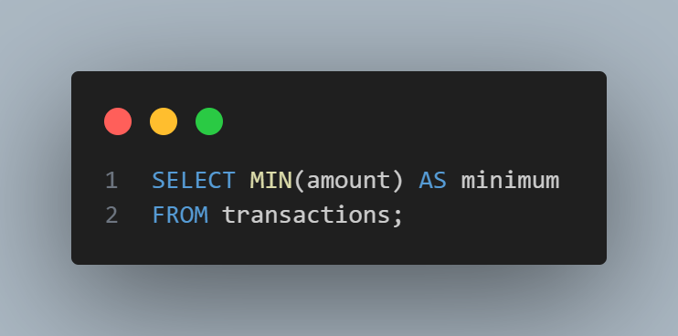
transactions
transaction_id | amount | customer_id | order_date
1000 | 4.99 | 3 | 2025-01-01
1001 | 2.89 | 2 | 2025-01-01
1002 | 3.38 | 3 | 2025-01-02
1003 | 4.99 | 1 | 2025-01-02
1004 | 1.00 | null | 2025-01-03
Result:
minimum
1.00

Slide 9
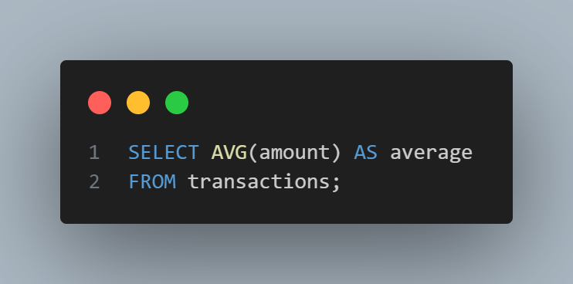
transactions
transaction_id | amount | customer_id | order_date
1000 | 4.99 | 3 | 2025-01-01
1001 | 2.89 | 2 | 2025-01-01
1002 | 3.38 | 3 | 2025-01-02
1003 | 4.99 | 1 | 2025-01-02
1004 | 1.00 | null | 2025-01-03
Result:
average
3.45

Slide 10

transactions
transaction_id | amount | customer_id | order_date
1000 | 4.99 | 3 | 2025-01-01
1001 | 2.89 | 2 | 2025-01-01
1002 | 3.38 | 3 | 2025-01-02
1003 | 4.99 | 1 | 2025-01-02
1004 | 1.00 | null | 2025-01-03
Result:
sum
17.25

Slide 11
SQL GROUP BY
The GROUP BY statement groups rows that have the same values into summary rows.
The GROUP BY statement is often used with aggregate functions (COUNT(), MAX(), MIN(), SUM(), AVG()) to group the result-set by one or more columns.

Slide 12
transactions
transaction_id | amount | customer_id | order_date
1000 | 4.99 | 3 | 2025-01-01
1001 | 2.89 | 2 | 2025-01-01
1002 | 3.38 | 3 | 2025-01-02
1003 | 4.99 | 1 | 2025-01-02
1004 | 1.00 | null | 2025-01-03
1005 | 2.49 | 4 | 2025-01-03
1006 | 5.48 | null | 2025-01-03

Slide 13
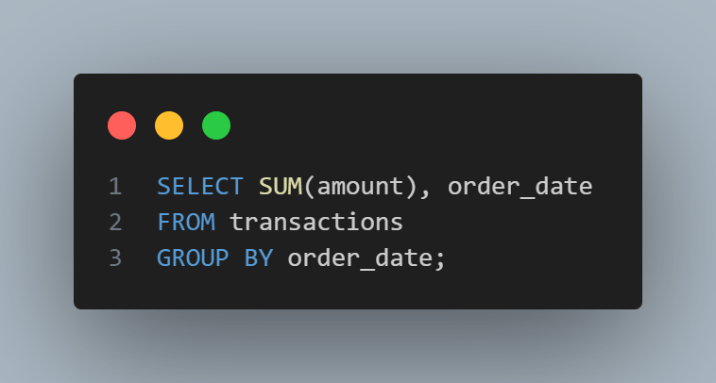
transactions
transaction_id | amount | customer_id | order_date
1000 | 4.99 | 3 | 2025-01-01
1001 | 2.89 | 2 | 2025-01-01
1002 | 3.38 | 3 | 2025-01-02
1003 | 4.99 | 1 | 2025-01-02
1004 | 1.00 | null | 2025-01-03
1005 | 2.49 | 4 | 2025-01-03
1006 | 5.48 | null | 2025-01-03
Result:
SUM(amount) | order_date
7.88 | 2025-01-01
8.37 | 2025-01-02
8.97 | 2025-01-03

Slide 14

transactions
transaction_id | amount | customer_id | order_date
1000 | 4.99 | 3 | 2025-01-01
1001 | 2.89 | 2 | 2025-01-01
1002 | 3.38 | 3 | 2025-01-02
1003 | 4.99 | 1 | 2025-01-02
1004 | 1.00 | null | 2025-01-03
1005 | 2.49 | 4 | 2025-01-03
1006 | 5.48 | null | 2025-01-03
Result:
MAX(amount) | order_date
4.99 | 2025-01-01
4.99 | 2025-01-02
5.48 | 2025-01-03

Slide 15

transactions
transaction_id | amount | customer_id | order_date
1000 | 4.99 | 3 | 2025-01-01
1001 | 2.89 | 2 | 2025-01-01
1002 | 3.38 | 3 | 2025-01-02
1003 | 4.99 | 1 | 2025-01-02
1004 | 1.00 | null | 2025-01-03
1005 | 2.49 | 4 | 2025-01-03
1006 | 5.48 | null | 2025-01-03
Result:
MIN(amount) | order_date
2.89 | 2025-01-01
3.38 | 2025-01-02
1.00 | 2025-01-03

Slide 16

transactions
transaction_id | amount | customer_id | order_date
1000 | 4.99 | 3 | 2025-01-01
1001 | 2.89 | 2 | 2025-01-01
1002 | 3.38 | 3 | 2025-01-02
1003 | 4.99 | 1 | 2025-01-02
1004 | 1.00 | null | 2025-01-03
1005 | 2.49 | 4 | 2025-01-03
1006 | 5.48 | null | 2025-01-03
Result:
AVG(amount) | order_date
3.940 | 2025-01-01
4.185 | 2025-01-02
2.990 | 2025-01-03

Slide 17
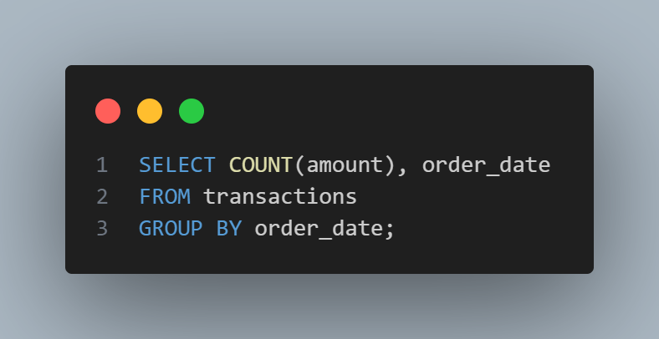
transactions
transaction_id | amount | customer_id | order_date
1000 | 4.99 | 3 | 2025-01-01
1001 | 2.89 | 2 | 2025-01-01
1002 | 3.38 | 3 | 2025-01-02
1003 | 4.99 | 1 | 2025-01-02
1004 | 1.00 | null | 2025-01-03
1005 | 2.49 | 4 | 2025-01-03
1006 | 5.48 | null | 2025-01-03
Result:
COUNT(amount) | order_date
2 | 2025-01-01
2 | 2025-01-02
3 | 2025-01-03

Slide 18

transactions
transaction_id | amount | customer_id | order_date
1000 | 4.99 | 3 | 2025-01-01
1001 | 2.89 | 2 | 2025-01-01
1002 | 3.38 | 3 | 2025-01-02
1003 | 4.99 | 1 | 2025-01-02
1004 | 1.00 | null | 2025-01-03
1005 | 2.49 | 4 | 2025-01-03
1006 | 5.48 | null | 2025-01-03
Result:
COUNT(amount) | customer_id
2 | null
1 | 1
1 | 2
2 | 3
1 | 4

Slide 19
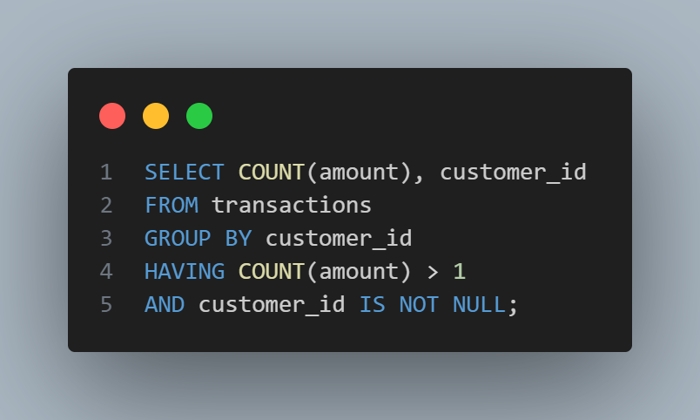
transactions
transaction_id | amount | customer_id | order_date
1000 | 4.99 | 3 | 2025-01-01
1001 | 2.89 | 2 | 2025-01-01
1002 | 3.38 | 3 | 2025-01-02
1003 | 4.99 | 1 | 2025-01-02
1004 | 1.00 | null | 2025-01-03
1005 | 2.49 | 4 | 2025-01-03
1006 | 5.48 | null | 2025-01-03
Result:
COUNT(amount) | customer_id
1 | 1
1 | 2
2 | 3
1 | 4

